Slide 1
HTTP Refresher
Now with REST!

Slide 2
🖖
Greg Gómez
Web Developer
UNM IT
gogogo@unm.edu

Slide 3
Overview Of Today’s Presentation
HTTP
REST

Slide 4
Notes:
As you know, the only thing guaranteed to make a successful presentation is cute cats.

Slide 5
HTTP
HyperText Transfer Protocol

Slide 6
HTTP
“HTTP is the foundation of data communication for the World Wide Web, where hypertext documents include hyperlinks to other resources that the user can easily access.... HTTP was developed to facilitate hypertext and the World Wide Web.”
https://en.wikipedia.org/wiki/Hypertext_Transfer_Protocol

Slide 7
HTTP
But it’s used for more than just delivering webpages
APIs
DevOps
Eg: git
REST
Notes:
REST is emphasized because we will be talking about it.

Slide 8
HTTP - History
Tim Berners-Lee invented HTTP in 1989.
First documented in 1991 (V0.9).
V1.0 – 1996
V1.1 – 1997
V2.0 – 2015
Notes:
V2.0 is grayed out because we won’t be talking about it.

Slide 9
HTTP - Background
While getting a page, a web browser will typically make many HTTP requests.
We’ll be focusing on individual HTTP transactions, not on web pages.
Notes:
The browser will get the page, start to scan it for other things to get (CSS, scripts, images, etc.). Then it will begin getting those resources.
I won’t be going into how connection are made, how binary files are negotiated, or how streams work (because I don’t know!!!)

Slide 10
Caveat
I’ll be doing some hand waving through network connections, encrypted connections (SSL), binary files, streaming, etc.
Notes:
The browser will get the page, start to scan it for other things to get (CSS, scripts, images, etc.). Then it will begin getting those resources.
I won’t be going into how connection are made, how binary files are negotiated, or how streams work (because I don’t know!!!)

Slide 11
HTTP
Please note that in the following slides, the transactions are in plain text!

Slide 12
HTTP – Request - Format
METHOD path HTTP Version
Headers...
Body...

Slide 13
HTTP – Request - Example
GET / HTTP/1.1 ⏎
Host: www.php.net ⏎
⏎
Notes:
There’s no Body for a GET. We’ll cover Request Bodies soon, though!
Note the linefeeds! They’re part of the request.
Remember: this is plain text.

Slide 14
HTTP – Response - Format
<HTTP Version> <Status Code> <Status Message>
Headers...
Body...
Notes:
The Body is optional here, too.

Slide 15
HTTP – Response - Example
HTTP/1.1 200 OK ⏎
Date: Mon, 08 Oct 2018 20:49:08 GMT ⏎ Server: Apache/2.4.6 (CentOS) OpenSSL/1.0.2k-fips ⏎ X-Powered-By: PHP/7.1.10 ⏎ ⏎
<!DOCTYPE html> <html xmlns="http://www.w3.org/1999/xhtml" lang="en"> <head> ...
Notes:
Note the newlines! They’re part of the

Slide 16
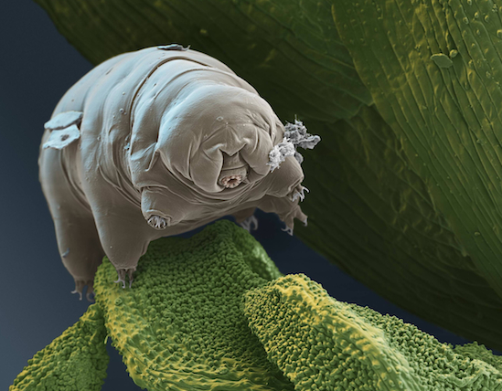
Tardigrades, also known colloquially as water bears, or moss piglets) are a phylum of water-dwelling, eight-legged, segmented micro-animals.

Slide 17
HTTP - Demonstration
Connect to a web site using telnet
Issue a proper Request
Examine the Response
Let’s go!
Notes:
Don’t do it, yet, check out the next slide first!!!

Slide 18
HTTP - Demonstration
Oops, first, what’s telnet?
A protocol that allows a user on one computer to connect to another computer and send plain text between them.
Client/server architecture.
It was the way to connect to remote machines for a long time.
But it’s insecure, and has largely been replaced by ssh
Now, let’s go!
Notes:
Demo

Slide 19
HTTP - Demonstration
That’s all there is to it.
Again: plain text.
Simple.
At least though HTTP 1.1...
Notes:
HTTP 2.0 uses binary frames, not plain text. 🤔

Slide 20
HTTP – Request Methods
GET
HEAD
POST
PUT
DELETE
CONNECT
OPTIONS
TRACE
https://tools.ietf.org/html/rfc7231#section-4

Slide 21
HTTP – Request Methods - GET
The GET method requests transfer of a current selected representation for the target resource.
https://tools.ietf.org/html/rfc7231#section-4
Notes:
You can skip through these. They’re here as a reference.

Slide 22
HTTP – Request Methods - HEAD
The HEAD method is identical to GET except that the server MUST NOT send a message body in the response (i.e., the response terminates at the end of the header section).
https://tools.ietf.org/html/rfc7231#section-4
Notes:
But, let’s demo this one!

Slide 23
HTTP – Request Methods - POST
The POST method requests that the target resource process the representation enclosed in the request according to the resource's own specific semantics.
https://tools.ietf.org/html/rfc7231#section-4
Notes:
Oof, we need to demo this one! https://httpbin.org/post

Slide 24
HTTP – Request Methods - PUT
The PUT method requests that the state of the target resource be created or replaced with the state defined by the representation enclosed in the request message payload.
https://tools.ietf.org/html/rfc7231#section-4

Slide 25
HTTP – Request Methods - DELETE
The DELETE method requests that the origin server remove the association between the target resource and its current functionality.
https://tools.ietf.org/html/rfc7231#section-4

Slide 26
HTTP – Request Methods - CONNECT
The CONNECT method requests that the recipient establish a tunnel to the destination origin server identified by the request-target and, if successful, thereafter restrict its behavior to blind forwarding of packets, in both directions, until the tunnel is closed.
https://tools.ietf.org/html/rfc7231#section-4

Slide 27
HTTP – Request Methods - OPTIONS
The OPTIONS method requests information about the communication options available for the target resource, at either the origin server or an intervening intermediary.
https://tools.ietf.org/html/rfc7231#section-4

Slide 28
HTTP – Request Methods - TRACE
The TRACE method requests a remote, application-level loop-back of the request message.
https://tools.ietf.org/html/rfc7231#section-4

Slide 29
HTTP - Cookies
It’s just a header, after all.
Just keep in mind HTTP is stateless. So, cookies are used to persist state.
Notes:
We’re not going too deeply into cookies here. The main idea is that there’s a Cookie header.

Slide 31
Her Royal Highness Xochiqueztal “Xochi” “Lala” MacLalavich Gómez

Slide 32
HTTP – Response Codes
HTTP has a number of response codes, as well.

Slide 33
HTTP – Response - Format
<HTTP Version> <Status Code> <Status Message>
Headers...
Body...
Notes:
This is here for review.

Slide 34
HTTP – Response - Example
HTTP/1.1 200 OK ⏎
Date: Mon, 08 Oct 2018 20:49:08 GMT ⏎ Server: Apache/2.4.6 (CentOS) OpenSSL/1.0.2k-fips ⏎ X-Powered-By: PHP/7.1.10 ⏎ ⏎
<!DOCTYPE html> <html xmlns="http://www.w3.org/1999/xhtml" lang="en"> <head> ...

Slide 35
HTTP – Response Codes
1xx Informational response
2xx Success
3xx Redirection
4xx Client errors
5xx Server errors
https://en.wikipedia.org/wiki/List_of_HTTP_status_codes

Slide 36
HTTP – Response Codes
The most famous one:
404 Not Found
Others:
https://en.wikipedia.org/wiki/List_of_HTTP_status_codes#1xx_Informational_response

Slide 37
Notes:
I know, I have no shame.

Slide 38
REST - Background
REpresentational State Transfer
A uniform way of implementing web resources.
Defines how to access them,
and the responses that are allowed
using HTTP.

Slide 39
REST - Background
“‘Web resources’ were first defined on the World Wide Web as documents or files identified by their URLs. However, today they have a much more generic and abstract definition that encompasses every thing or entity that can be identified, named, addressed, or handled, in any way whatsoever, on the web. In a RESTful web service, requests made to a resource's URI will elicit a response with a payload formatted in either HTML, XML, JSON, or some other format.”
https://en.wikipedia.org/wiki/Representational_state_transfer

Slide 40
REST - Background
“...there is no ‘official’ standard for RESTful Web APIs. This is because REST is an architectural style.... REST is not a standard in itself, but RESTful implementations make use of standards, such as HTTP, URI, JSON, and XML.”
https://en.wikipedia.org/wiki/Representational_state_transfer

Slide 41
Caveat
Because there is no official standard, this overview won’t touch on every aspect of REST, nor is it authoritative.
YMMV.
Caveat Emptor.

Slide 42
REST - Background
In the beginning...
...HTTP was used to retrieve files from web servers.
And that was it.

Slide 43
REST – Key Concept
Key concept: there’s nothing that says that HTTP has to return an HTML file. Images are a good example.
But even with plain (HTML) text, the Response can be anything (XML, JSON, CSV, Plain Text).

Slide 44
REST – Key Concept
Key concept: there’s nothing that says that a web browser has to be a client.
That’s why I demonstrated manual connections earlier.

Slide 45
REST – An Example (Sort Of)
RSS – Really Simple Syndication
XML
Podcasts
Actually uses RSS
Notes:
These are examples of files that are retrieved that might be familiar to you.

Slide 46
REST
How is it related to HTTP?

Slide 47
REST – The Methods
GET
PUT
PATCH
POST
DELETE
Notes:
This slide introduces the methods; click through to get their meanings.

Slide 48
REST – The Methods
GET
PUT
PATCH
POST
DELETE
Various actions on the resource.
Basically, CRUD (Create, Read, Update and Delete).
Notes:
This slide introduces the methods; click through to get their meanings.

Slide 49
REST – The Methods
GET
PUT
PATCH
POST
DELETE
These define an API (Application Program Interface)
Notes:
This slide introduces the methods; click through to get their meanings.

Slide 50
REST – The Methods
GET – Retrieve a record
PUT – Replace a record (or Create a new record)
PATCH – Update a record
POST – Create a new record (or Create a new Collection)
DELETE – Delete a record
Notes:
‘Record’ is used loosely here. I tend to think of REST in terms of CRUD.

Slide 51
REST – Parameters
Can be passed as part of a URL
GET /myapp?id=123&format=json
GET /myapp/id/123/format/json
Notes:
‘Record’ is used loosely here. I tend to think of REST in terms of CRUD.

Slide 52
REST – Parameters
Or in the Body of a Request
POST http://MyService/Person/
Host: MyService
Content-Type: text/xml; charset=utf-8
Content-Length: 123
<?xml version="1.0" encoding="utf-8"?>
<Person>
<ID>1</ID>
<Name>Gregorio</Name>
<Email>gogogo@unm.edu</Email>
</Person>
Notes:
‘Record’ is used loosely here. I tend to think of REST in terms of CRUD.

Slide 53
REST – Content-Type Header
A REST service should include a Content-Type header in its response
Content-Type is used to help the consumer know what kind of content to expect.

Slide 54
REST – Content-Type Header
Examples:
application/json
text/html
text/plain
application/xml
text/csv
text/css
application/msword

Slide 55
REST – Accept Header
The client can also ask for a particular type
Uses the same codes as Content-Type.

Slide 56
REST – Content Negotiation
The client could also include something in the request
URL: someservice.com/type/xml; someservice.com?type=json
Of course this all depends upon what the application is capable of.
Did I mention that REST isn’t a standard?

Slide 57
REST – Creating REST APIs
These days, writing REST-based web services is pretty easy.
Most frameworks support REST
Laravel (php) favors REST for all of it’s transactions
Laravel fakes PUT, PATCH, and DELETE with hidden form fields.
YMMV.

Slide 58
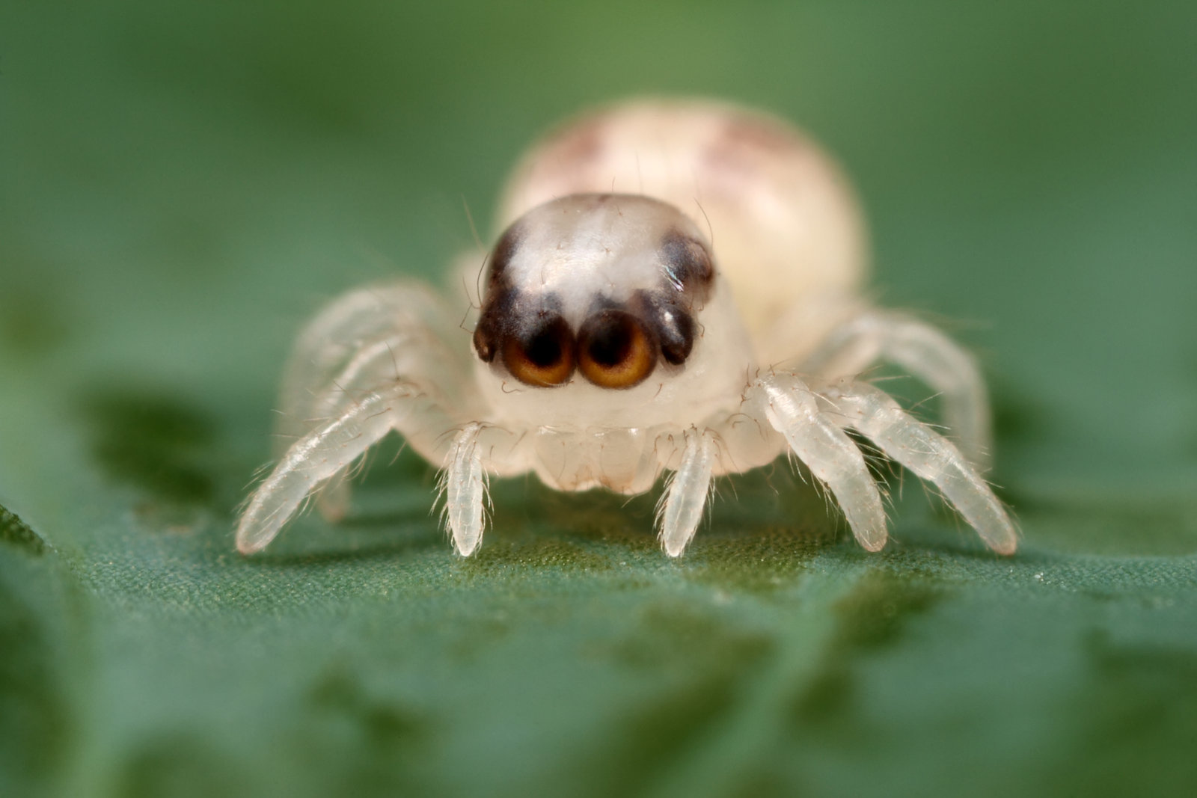
Happy Halloween!

Slide 59
REST - Demonstration
This time, we’ll use cURL.
cURL:
Client URL.
A command line tool (and library) for getting content.

Slide 60
REST – Security
Out of scope for this presentation, but...
Use HTTPS.
Don’t pass things in the URL string.
Use API keys
Restrict API methods
Don’t trust parameters (validate all data)
Use a framework

Slide 61
REST – Other Issues
Same Origin Policy
CORS

Slide 62
HTTP & REST – Other Issues
Despite being simple, HTTP and REST are surprisingly robust and subtle.
YMMV

Slide 63
🖖 🐈
Greg Gómez
Web Developer
UNM IT
gogogo@unm.edu

Slide 64
https://thecatapi.com/
Notes:
I know, I have no shame.

Slide 65
THANK YOU!
QUESTIONS?
FOLLOW US
fb.me/it.unm unm_it @unm_it @unm_cio @unm_it_alerts

Slide 66
Op Cit (Incomplete)
https://www.restapitutorial.com/httpstatuscodes.html
https://en.wikipedia.org/wiki/Representational_state_transfer
https://restfulapi.net/
https://www.restapitutorial.com/lessons/restquicktips.html
https://thecatapi.com/
https://www.owasp.org/index.php/REST_Security_Cheat_Sheet

Slide 67
REST
Template....

